Slide 1

Applied Data Science Capstone Project
Sindhuja Chandrasekaran

Slide 2
Executive Summary
This capstone project is about SpaceX Falcon 9 first stage Landing Prediction.
Analysis the likelihood of the Falcon 9 first stage landing successfully.
SpaceX lists the cost of Falcon 9 rocket launches on its website as 62 million dollars, while other providers charge more than 165 million dollars for each launch,
The significant portion of the savings resulting from SpaceX's capability to reuse the first stage.
Thus, our objective is to predict whether the first stage will land, we can also infer the launch cost.

Slide 3
Table of Contents
Introduction.
Methodology.
Data Collection
EDA
EDA with SQL
Predictive Analysis
Key Findings.
Conclusion.

Slide 4
Introduction
Unlike other providers SpaceX quotes Much lesser cost for rocket launches mainly due to the reuse of the first stage.
What if we determine the prediction of successful landing of the first stage, which can be used to bid against SpaceX?
For this purpose we can use Prediction Analysis using Machine Learning algorithms.

Slide 5
Methodology
Data collection.
Web scraping.
Data Wrangling and processing.
Exploratory analysis using SQL and Python visualization tools.
Data analytics using Folium Interactive maps and Plotly Dshboards.
Predictive analysis using Machine Learning Classification algorithms.

Slide 6
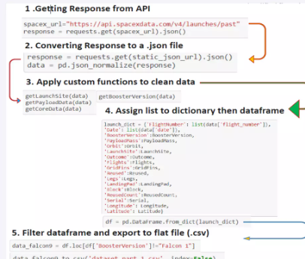
Data Collection

Slide 7
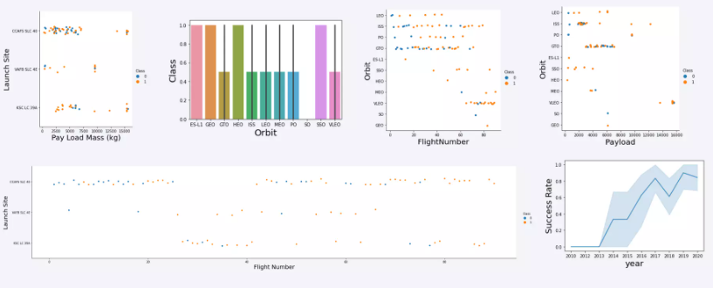
Exploratory data analysis

Slide 8
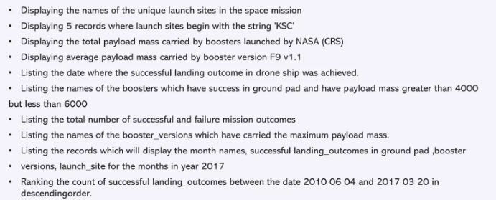
EDA with SQL query

Slide 9
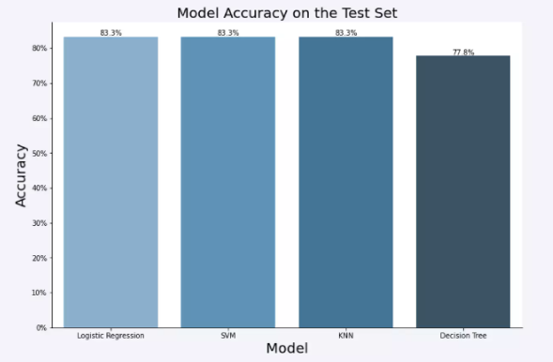
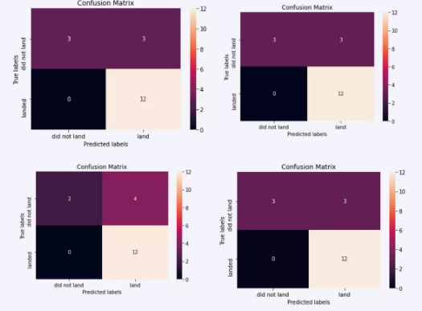
Predictive Analysis

Slide 10
Key Findings
The key findings from the data analysis is shown using the graphs and charts.
We have used Folium and Plotly dash to plot the graphs and charts.
The following slides explains the:
Orbit Vs. Success rate.
Payload Vs. Launch site
Launch success over the years.
Success launches – Pie chart.
Model accuracy
Confusion matrix

Slide 11
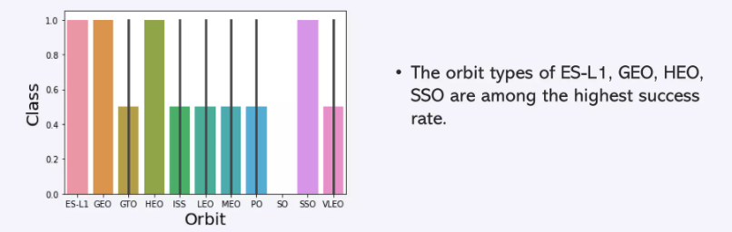
Orbit Vs. Success Rate

Slide 12
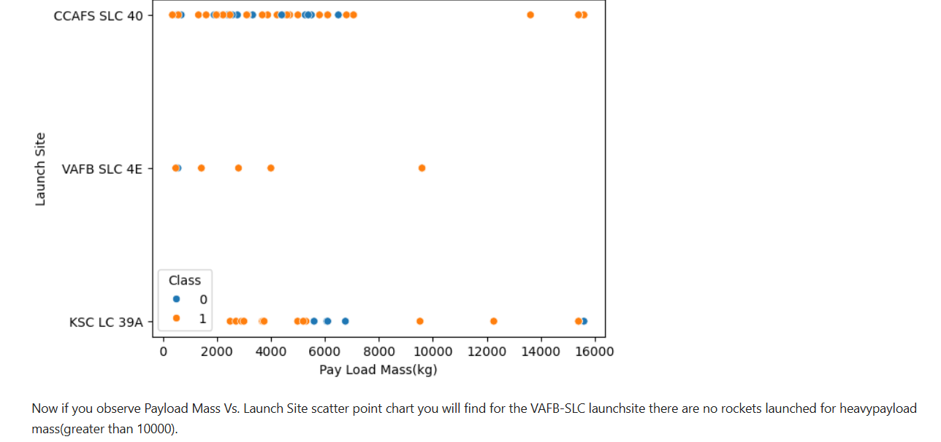
PayLoad Vs. LaunchSite

Slide 13
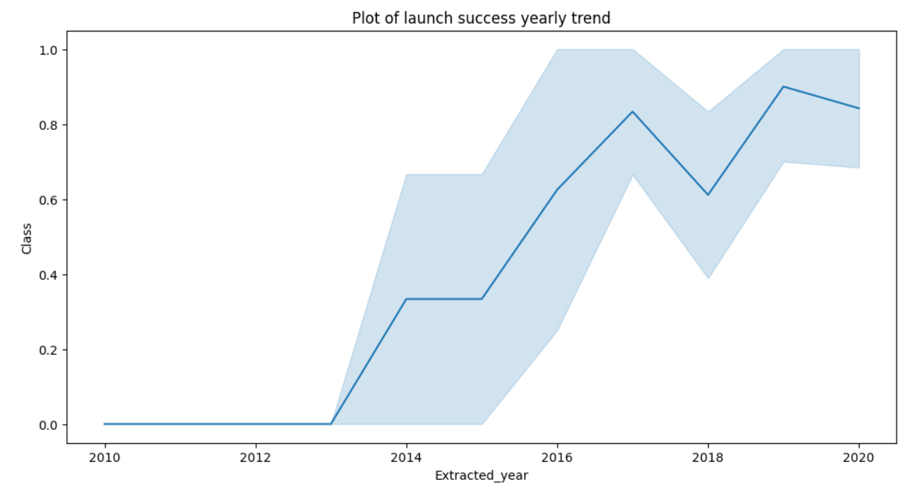
Launch Success Yearly Trend

Slide 14
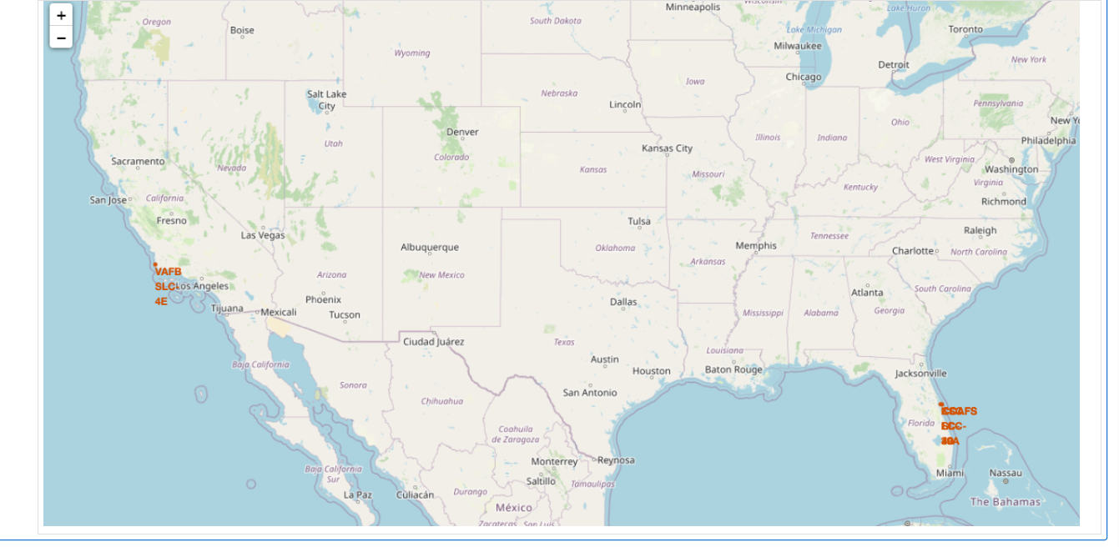
Landing Success and Failure on Map

Slide 15
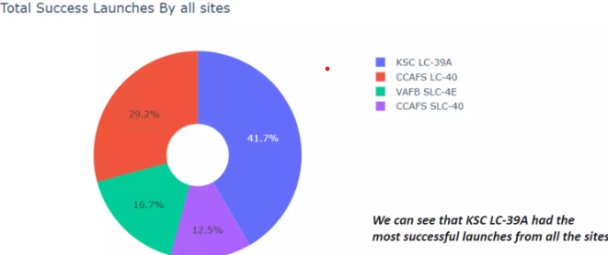
Success Launches- Pie Chart

Slide 16
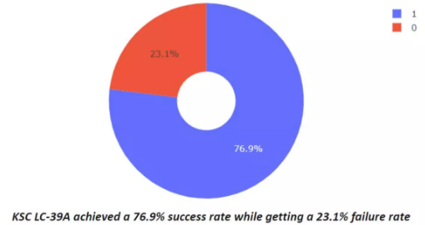
Success Rate by KSC LC-39A

Slide 17
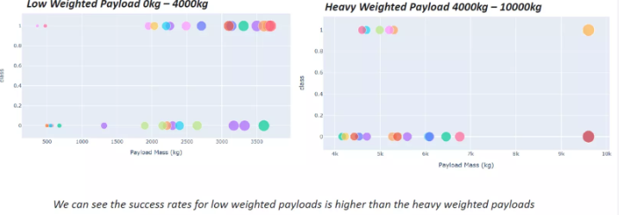
PayLoad Vs. Launch Outcome

Slide 18
Prediction Analysis- Model Accuracy

Slide 19
Confusion Matrix

Slide 20
Conclusion
Low Weight Payloads perform better than Heavier Payloads.
Orbits ES L1,GEO,HEO and SSO have the highest success rate.
KSC LC-39A had the most succeful launches.
The success of the SpaceX launches is directly proportional to the years. As year goes on, they will eventually perfect the launches.
The SVM, KNN and Logistic Regression models have predicted accurately.

